Slide 1
Minimum Spanning Tree

Slide 2
Spanning tree - A spanning tree is the subgraph of an undirected connected graph.
Minimum Spanning tree - Minimum spanning tree can be defined as the spanning tree in which the sum of the weights of the edge is minimum. The weight of the spanning tree is the sum of the weights given to the edges of the spanning tree.

Slide 3
The next problem we will consider is that of finding a minimum spanning tree in an undirected graph. The problem makes sense for directed graphs but appears to be more difficult. Informally, a minimum spanning tree of an undirected graph G is a tree formed from graph edges that connects all the vertices of G at lowest total cost. A minimum spanning tree exists if and only if G is connected.

Slide 4
Notice that the number of edges in the minimum spanning tree is |V| - 1.
The minimum spanning tree is a tree because it is acyclic, it is spanning because it covers every edge, and it is minimum for the obvious reason. If we need to wire a house with a minimum of cable, then a minimum spanning tree problem needs to be solved. There are two basic algorithms to solve this problem; both are greedy.

Slide 5
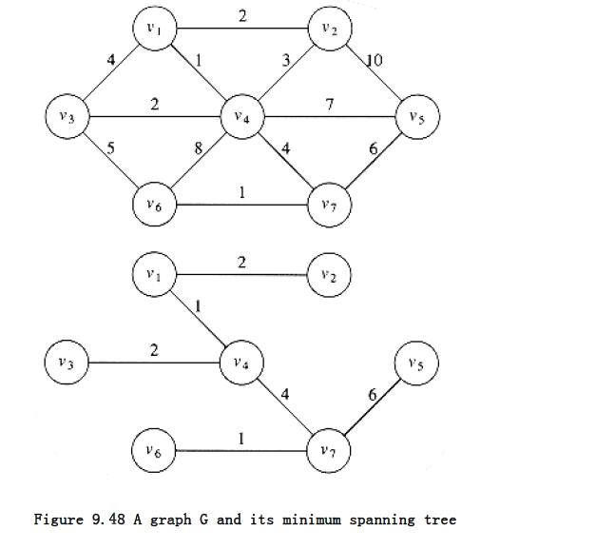

Slide 6
Prim's Algorithm
One way to compute a minimum spanning tree is to grow the tree in successive stages. In each stage, one node is picked as the root, and we add an edge, and thus an associated vertex, to the tree.
At any point in the algorithm, we can see that we have a set of vertices that have already been included in the tree; the rest of the vertices have not. The algorithm then finds, at each stage, a new vertex to add to the tree by choosing the edge (u, v) such that the cost of (u, v) is the smallest among all edges where u is in the tree and v is not.

Slide 7
Figure 9.49 shows how this algorithm would build the minimum spanning tree, starting from v1. Initially, v1 is in the tree as a root with no edges. Each step adds one edge and one vertex to the tree.

Slide 8
We can see that Prim's algorithm is essentially identical to Dijkstra's algorithm for shortest
paths.
As before, for each vertex we keep values d_{v} and p_{v} and an indication of whether it is known or unknown. dv is the weight of the shortest arc connecting v to a known vertex, and p_{v,} as before, is the last vertex to cause a change in dv. The rest of the algorithm is exactly the

Slide 9
The rest of the algorithm is exactly the same, with the exception that since the definition of d_{v} is different, so is the update rule.
For this problem, the update rule is even simpler than before: After a vertex v is selected, for each unknown w adjacent to v, d_{v} = min(d_{w}, c_{w,v}).

Slide 10
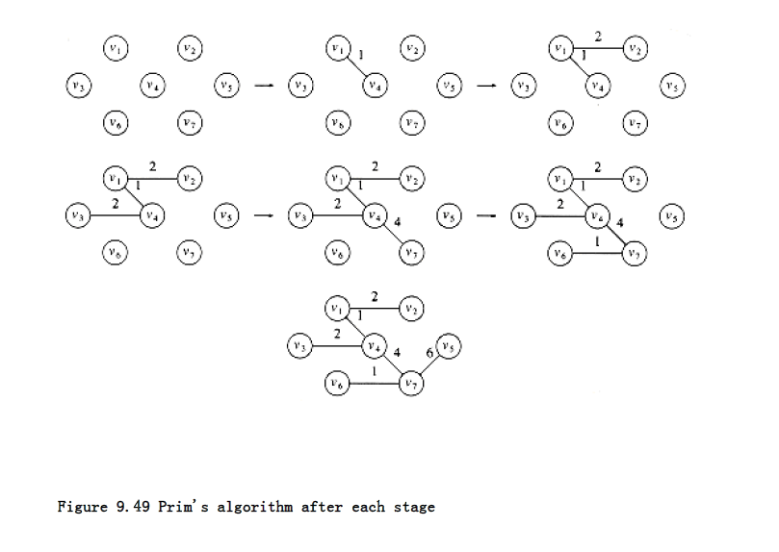

Slide 11
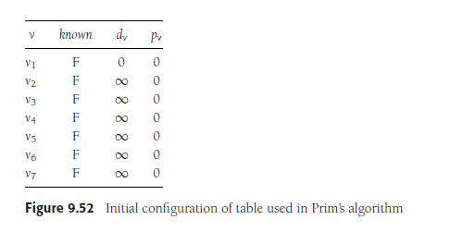

Slide 12
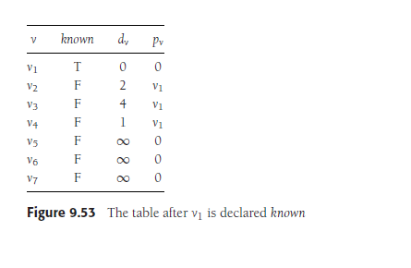

Slide 13
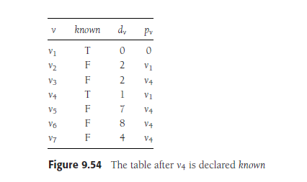

Slide 14
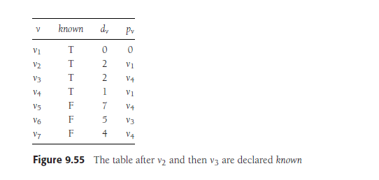

Slide 15
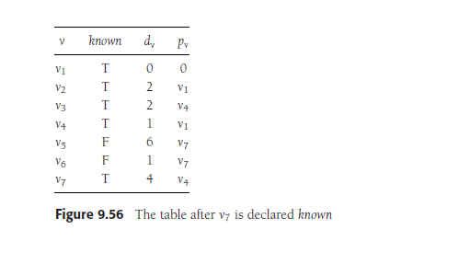

Slide 16
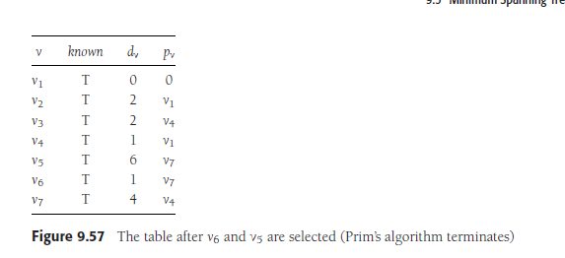

Slide 17
The initial configuration of the table is shown in Figure 9.52. v1 is selected, and v2, v3,
and v4 are updated. The table resulting from this is shown in Figure 9.53. The next vertexselected is v4. Every vertex is adjacent to v4. v1 is not examined, because it is known. V2 is unchanged, because it has dv = 2 and the edge cost from v4 to v2 is 3; all the rest are updated. Figure 9.54 shows the resulting table.

Slide 18
The next vertex chosen is v2 (arbitrarily breaking a tie). This does not affect any distances. Then v3 is chosen, which affects the
distance in v6, producing Figure 9.55. Figure 9.56 results from the selection of v7, which
forces v6 and v5 to be adjusted. v6 and then v5 are selected, completing the algorithm.

Slide 19
The final table is shown in Figure 9.57. The edges in the spanning tree can be read from the table: (v2, v1), (v3, v4), (v4, v1), (v5, v7), (v6, v7), (v7, v4). The total cost is 16.
The entire implementation of this algorithm is virtually identical to that of Dijkstra’s algorithm, and everything that was said about the analysis of Dijkstra’s algorithm applies
here. Be aware that Prim’s algorithm runs on undirected graphs, so when coding it, remember to put every edge in two adjacency lists. The running time is O(|V|²) without heaps,
which is optimal for dense graphs, and O(|E| log |V|) using binary heaps.

Slide 20
Prim's Algorithm pseudocode
T = ∅;
U = { 1 };
while (U ≠ V)
let (u, v) be the lowest cost edge such that u ∈
U and v ∈ V - U;
T = T ∪ {(u, v)}
U = U ∪ {v}

Slide 21
void
Prim’s( TABLE T )
{
vertex v, w;
for( ; ; )
{
v = smallest unknown distance vertex;
break;
T[v].known = TRUE;
for each w adjacent to v
if( !T[w].known )
if( Cv,w < T[w].dist )
{ /* update w */
decrease( T[w].dist to Cv,w );
T[w].path = v;
}
}
}

Slide 22
Prim's Algorithm Complexity
The time complexity of Prim's algorithm is O(E log V).

Slide 23
Algorithm
Step 1: Select a starting vertex
Step 2: Repeat Steps 3 and 4 until there are fringe vertices
Step 3: Select an edge 'e' connecting the tree vertex and fringe vertex that has minimum weight
Step 4: Add the selected edge and the vertex to the minimum spanning tree T
[END OF LOOP]
Step 5: EXIT

Slide 24
Time Complexity
Data structure used for the minimum edge weight
Adjacency matrix, linear searching - O(|V|²)
Adjacency list and binary heap-O(|E| log |V|)

Slide 25
Kruskal's Algorithm
A second greedy strategy is to continually select the edges in order of smallest weight and accept an edge if it does not cause a cycle. The action of the algorithm on the graph in the preceding example is shown in Figure 9.58.

Slide 27
Disjoint Set:
Two sets are called disjoint set if the intersection of two sets is ϕ i.e. NULL. A Disjoint-Set data structure that keeps records of a set of elements partitioned into several non-overlapping (Disjoint) subsets.
Union Find:
Union-Find algorithm performs two very useful operations -
Find:
To find the subset a particular element 'k' belongs to. It is generally used to check if two elements belong to the same subset or not.
Union:
It is used to combine two subsets into one. A union query, say Union(x, y) combines the set containing element x and set containing element y.

Slide 28
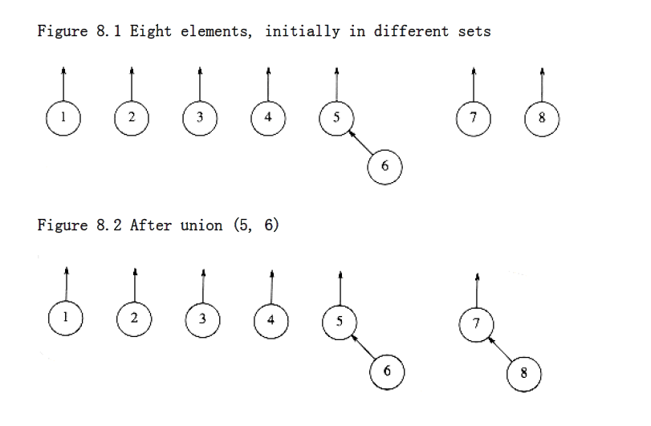

Slide 29
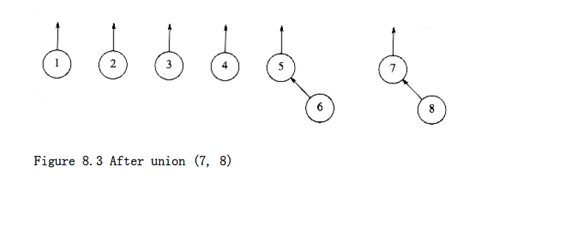

Slide 30
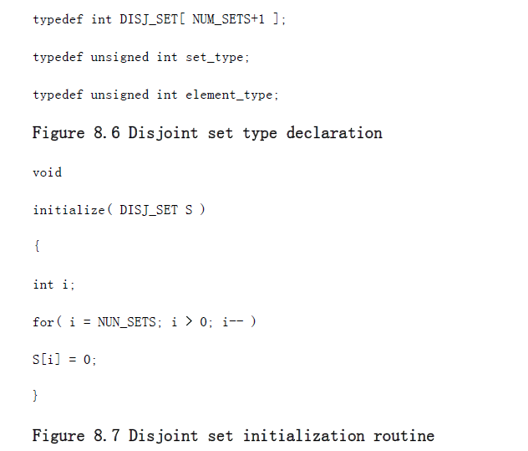

Slide 31
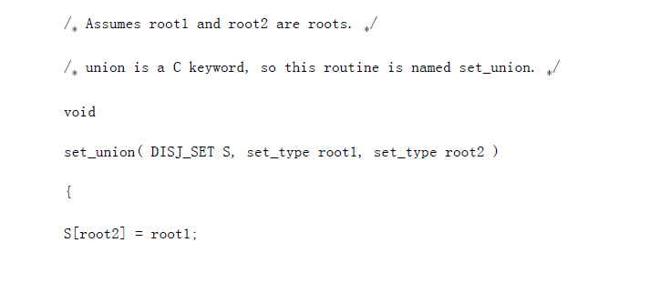
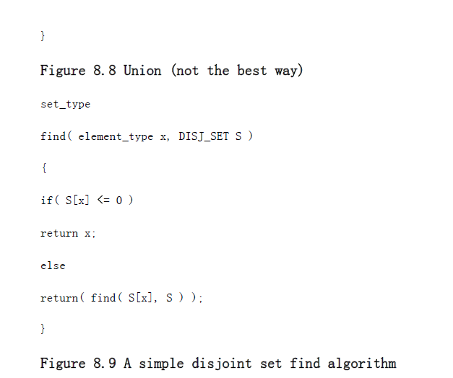

Slide 32
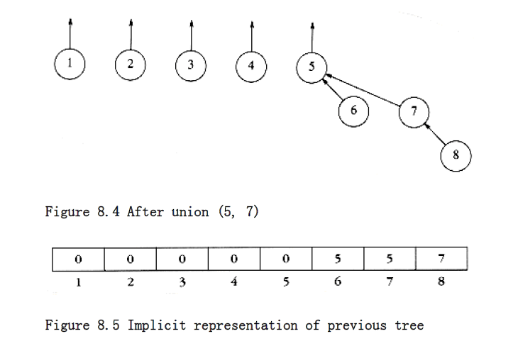

Slide 33
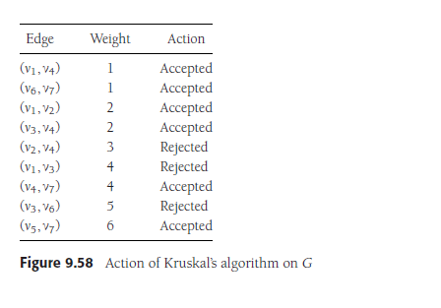

Slide 34
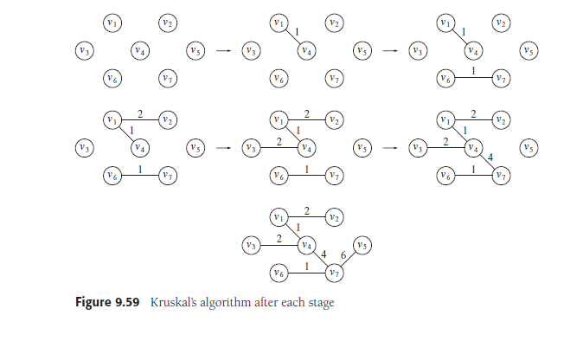

Slide 35
Formally, Kruskal’s algorithm maintains a forest—a collection of trees.
Initially, there are |V| single-node trees. Adding an edge merges two trees into one.
When the algorithm terminates, there is only one tree, and this is the minimum spanning tree.
Figure 9.59 shows the order in which edges are added to the forest.
The algorithm terminates when enough edges are accepted.
It turns out to be simple to decide whether edge (u, v) should be accepted or rejected.
The appropriate data structure is the union/find algorithm

Slide 36
The invariant we will use is that at any point in the process, two vertices belong to the same set if and only if they are connected in the current spanning forest.
Thus, each vertex is initially in its own set. If u and v are in the same set, the edge is rejected, because
since they are already connected, adding (u, v) would form a cycle. Otherwise, the edge is accepted, and a union is performed on the two sets containing u and v.
It is easy to see that this maintains the set invariant, because once the edge (u, v) is added to the spanning forest, if w was connected to u and x was connected to v, then x and w must now be connected, and thus belong in the same set.

Slide 37
The edges could be sorted to facilitate the selection, but building a heap in linear time is a much better idea. Then deleteMins give the edges to be tested in order.
Typically, only a small fraction of the edges need to be tested before the algorithm can terminate, although it is always possible that all the edges must be tried. For instance, if there was an extra vertex v8 and edge (v5, v8) of cost 100, all the edges would have to be examined. Function kruskal in Figure 9.60 finds a minimum spanning tree.
The worst-case running time of this algorithm is
O(|E| log |E|), which is dominated by the heap operations. Notice that since |E| = O(|V|²), this running time is actually O(|E| log |V|).

Slide 38
Pseudocode for Kruskal’s algorithm
{
e = delete_min( H ); /* e = (u, v) */
u_set = find( u, S );
v_set = find( v, S );
if( u_set != v_set )
{
/* accept the edge */
edges_accepted++;
set_union( S, u_set, v_set );
}
}
}
void
kruskal( graph G )
{
unsigned int edges_accepted;
DISJ_SET S;
PRIORITY_QUEUE H;
vertex u, v;
set_type u_set, v_set;
edge e;
initialize( S );
read_graph_into_heap_array( G, H );
build_heap( H );
edges_accepted = 0;
while( edges_accepted < NUM_VERTEX-1 )

